Slide 1





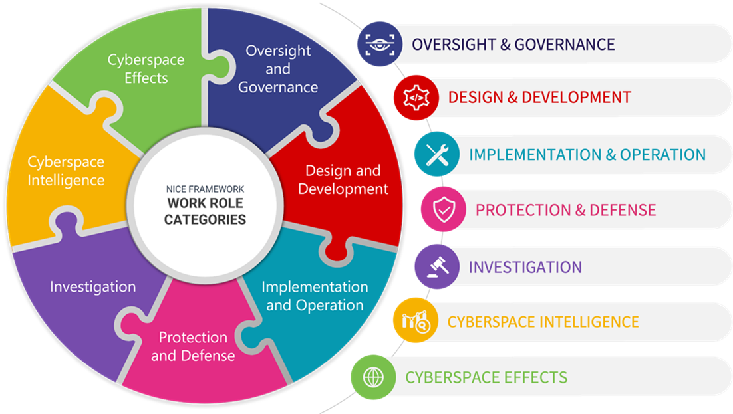


OVERSIGHT & GOVERNANCE
CYBERSPACE INTELLIGENCE
DESIGN & DEVELOPMENT
CYBERSPACE EFFECTS
PROTECTION & DEFENSE
IMPLEMENTATION & OPERATION
INVESTIGATION

Slide 3













Cybersecurity Researcher
Chief Information Security Officer (CISO)
1st Line Of Defense (LOD-1)
ESSENTIAL
Cyber Incident Responder (Art. 23)
Cybersecurity Implementer (Art. 21)
--
IMPORTANT
Cyber Threat Intelligence Specialist
Cybersecurity Architect (Art. 21)
______________
2nd Line Of Defense (LOD-2)
ESSENTIAL
Chief Information Security Officer (Art. 20-21)
Cyber Legal, Policy & Compliance Officer (Art. 20-21) (Art. 23)
Cybersecurity Educator (Art. 21)
Cybersecurity Risk Manager (Art. 21)
--
IMPORTANT
Penetration Tester
______________
3rd Line Of Defense (LOD-3)
IMPORTANT
Cybersecurity Auditor
______________
Special Expertise & Support
OPTIONAL
Digital Forensics Investigator
(Cybersecurity Researcher)
Cybersecurity Auditor
Cyber Legal, Policy and Compliance Officer
A
P
Cybersecurity Risk Manager
Improve
or Dispose
Plan
(Concept)
Penetration Tester
Cybersecurity Architect
Operate
(Maintain)
Implement
(Acquisition)
(Deployment)
Cyber Threat Intelligence Specialist
C
D
Cybersecurity Implementer
Digital Forensics Investigator
Cyber Incident Responder
Cybersecurity Educator
Notes:
Rôles en Cybersécurité: Classification par Couleur
Ce diaporama offre une vue d'ensemble des différents rôles en cybersécurité, classés par couleur pour une meilleure compréhension de leurs fonctions et responsabilités.
Cybersecurity Roles: Color Classification
This slideshow provides an overview of various cybersecurity roles, classified by color and according to the Plan-Do-Check-Act (PDCA) cycle for a better understanding of their functions and responsibilities.
1. **Blue**: roles involving the management and implementation of security policies.
* Chief Information Security Officer (CISO)
* Cyber Legal, Policy & Compliance Officer
* Cybersecurity Implementer
2. **Red**: roles requiring rapid intervention and incident management.
* Cyber Incident Responder
* Cybersecurity Risk Manager
* Penetration Tester
3. **Yellow**: analytical and research roles, often involved in threat assessment and auditing.
* Cyber Threat Intelligence Specialist
* Cybersecurity Auditor
* Digital Forensics Investigator
4. **Green**: roles in cybersecurity design, architecture, and education.
* Cybersecurity Architect
* Cybersecurity Educator
* Cybersecurity Researcher

Slide 4
1. Blue: roles involving the management and implementation of security policies.
* Chief Information Security Officer (CISO)
* Cyber Legal, Policy & Compliance Officer
* Cybersecurity Implementer
2. Red: roles requiring rapid intervention and incident management.
* Cyber Incident Responder
* Cybersecurity Risk Manager
* Penetration Tester
3. Yellow: analytical and research roles, often involved in threat assessment and auditing.
* Cyber Threat Intelligence Specialist
* Cybersecurity Auditor
* Digital Forensics Investigator
4. Green: roles in cybersecurity design, architecture, and education.
* Cybersecurity Architect
* Cybersecurity Educator
* Cybersecurity Researcher
Chief Information Security Officer (CISO)
Cybersecurity Auditor
Cyber Legal, Policy and Compliance Officer
Cyber Threat Intelligence Specialist
Cybersecurity Implementer
Digital Forensics Investigator
Cybersecurity Risk Manager
Cybersecurity Researcher
Cyber Incident Responder
Cybersecurity Architect
Penetration Tester
Cybersecurity Educator

Slide 5
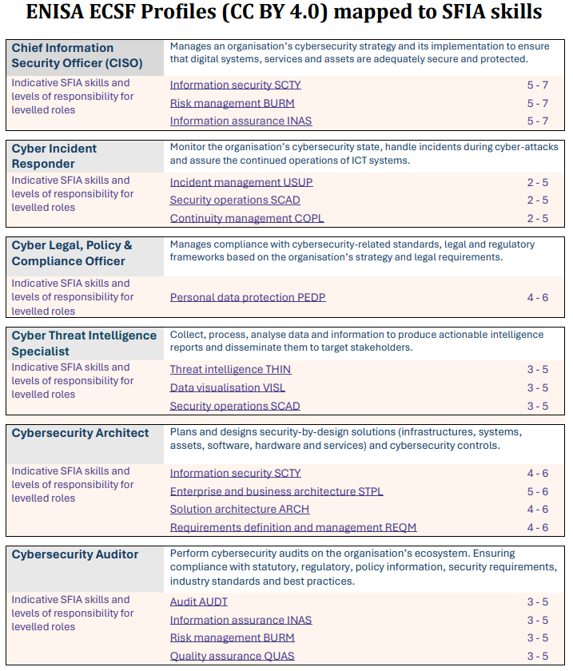
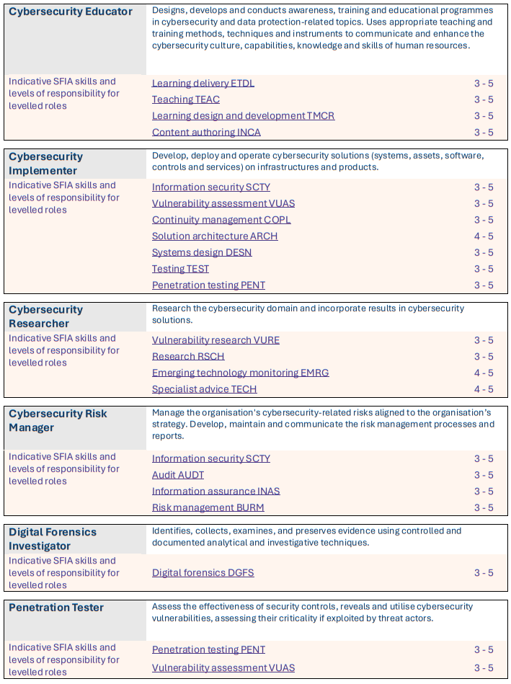
Notes:
https://sfia-online.org/en/assets/cybersecurity/enisa-profiles-mapped-to-sfia-skills.pdf

Slide 6
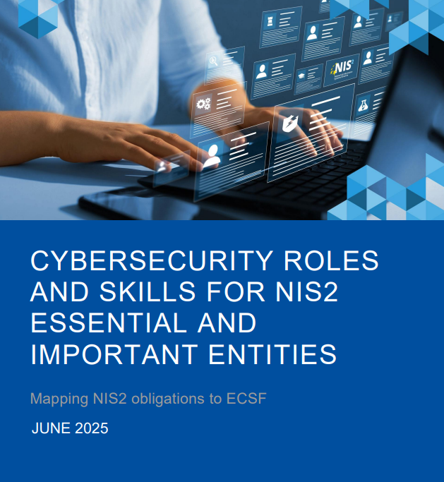


https://www.enisa.europa.eu/sites/default/files/2025-06/Mapping%20NIS%202%20obligations%20with%20ECSF%20role%20profiles.pdf

Slide 7
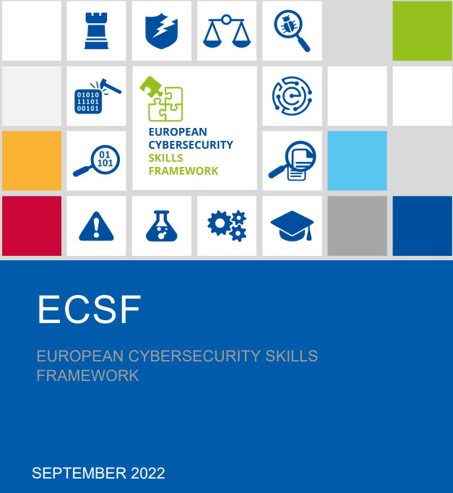

https://www.enisa.europa.eu/sites/default/files/publications/European%20Cybersecurity%20Skills%20Framework%20Role%20Profiles.pdf

Slide 8
Cybersecurity Researcher
Chief Information Security Officer (CISO)
1st Line Of Defense (LOD-1)
ESSENTIAL
Cyber Incident Responder (Art. 23)
Cybersecurity Implementer (Art. 21)
--
IMPORTANT
Cyber Threat Intelligence Specialist
Cybersecurity Architect (Art. 21)
______________
2nd Line Of Defense (LOD-2)
ESSENTIAL
Chief Information Security Officer (Art. 20-21)
Cyber Legal, Policy & Compliance Officer (Art. 20-21) (Art. 23)
Cybersecurity Educator (Art. 21)
Cybersecurity Risk Manager (Art. 21)
--
IMPORTANT
Penetration Tester
______________
3rd Line Of Defense (LOD-3)
IMPORTANT
Cybersecurity Auditor
______________
Special Expertise & Support
OPTIONAL
Digital Forensics Investigator
Cybersecurity Auditor
Cyber Legal, Policy and Compliance Officer
A
P
Cybersecurity Risk Manager
Improve
or Dispose
Plan
(Concept)
Penetration Tester
Cybersecurity Architect
Operate
(Maintain)
Implement
(Acquisition)
(Deployment)
Cyber Threat Intelligence Specialist
C
D
Cybersecurity Implementer
Digital Forensics Investigator
Cyber Incident Responder
Cybersecurity Educator
Notes:
Rôles en Cybersécurité: Classification par Couleur
Ce diaporama offre une vue d'ensemble des différents rôles en cybersécurité, classés par couleur pour une meilleure compréhension de leurs fonctions et responsabilités.
Cybersecurity Roles: Color Classification
This slideshow provides an overview of various cybersecurity roles, classified by color and according to the Plan-Do-Check-Act (PDCA) cycle for a better understanding of their functions and responsibilities.
1. **Blue**: roles involving the management and implementation of security policies.
* Chief Information Security Officer (CISO)
* Cyber Legal, Policy & Compliance Officer
* Cybersecurity Implementer
2. **Red**: roles requiring rapid intervention and incident management.
* Cyber Incident Responder
* Cybersecurity Risk Manager
* Penetration Tester
3. **Yellow**: analytical and research roles, often involved in threat assessment and auditing.
* Cyber Threat Intelligence Specialist
* Cybersecurity Auditor
* Digital Forensics Investigator
4. **Green**: roles in cybersecurity design, architecture, and education.
* Cybersecurity Architect
* Cybersecurity Educator
* Cybersecurity Researcher

Slide 9
2.1 CHIEF INFORMATION SECURITY OFFICER (CISO)
Chief Information Security Officer (CISO)
Summary statement
Manages an organisation’s cybersecurity strategy and its implementation to ensure that digital systems, services and assets are adequately secure and protected.
Mission
Defines, maintains and communicates the cybersecurity vision, strategy, policies and procedures. Manages the implementation of the cybersecurity policy across the organisation. Assures information exchange with external authorities and professional bodies.

Slide 10
2.2 CYBER INCIDENT RESPONDER
Cyber Incident Responder
Summary statement
Monitor the organisation’s cybersecurity state, handle incidents during cyber-attacks and assure the continued operations of ICT systems.
Mission
Monitors and assesses systems’ cybersecurity state. Analyses, evaluates and mitigates the impact of cybersecurity incidents. Identifies cyber incidents root causes and malicious actors. According to the organisation’s Incident Response Plan, restores systems’ and processes’ functionalities to an operational state, collecting evidences and documenting actions taken

Slide 11
2.3 CYBER LEGAL, POLICY & COMPLIANCE OFFICER
Cyber Legal, Policy and Compliance Officer
Summary statement
Monitor the organisation’s cybersecurity state, handle incidents during cyber-attacks and assure the continued operations of ICT systems.
Mission
Monitors and assesses systems’ cybersecurity state. Analyses, evaluates and mitigates the impact of cybersecurity incidents. Identifies cyber incidents root causes and malicious actors. According to the organisation’s Incident Response Plan, restores systems’ and processes’ functionalities to an operational state, collecting evidences and documenting actions taken

Slide 12
2.4 CYBER THREAT INTELLIGENCE SPECIALIST
Summary statement
Collect, process, analyse data and information to produce actionable intelligence reports and disseminate them to target stakeholders.
Mission
Manages cyber threat intelligence life cycle including cyber threat information collection, analysis and production of actionable intelligence and dissemination to security stakeholders and the CTI community, at a tactical, operational and strategic level. Identifies and monitors the Tactics, Techniques and Procedures (TTPs) used by cyber threat actors and their trends, track threat actors’
Cyber Threat Intelligence Specialist

Slide 13
2.5 CYBERSECURITY ARCHITECT
Cybersecurity Architect
Summary statement
Plans and designs security-by-design solutions (infrastructures, systems, assets, software, hardware and services) and cybersecurity controls.
Mission
Designs solutions based on security-by-design and privacy-by-design principles. Creates and continuously improves architectural models and develops appropriate architectural documentation and specifications. Coordinate secure development, integration and maintenance of cybersecurity components in line with standards and other related requirements.

Slide 14
2.6 CYBERSECURITY AUDITOR
Cybersecurity Auditor
Summary statement
Perform cybersecurity audits on the organisation’s ecosystem. Ensuring compliance with statutory, regulatory, policy information, security requirements, industry standards and best practices.
Mission
Conducts independent reviews to assess the effectiveness of processes and controls and the overall compliance with the organisation's legal and regulatory frameworks policies. Evaluates, tests and verifies cybersecurity-related products (systems, hardware, software and services), functions and policies ensuring, compliance with guidelines, standards and regulations.

Slide 15
2.7 CYBERSECURITY EDUCATOR
Cybersecurity Educator
Summary statement
Improves cybersecurity knowledge, skills and competencies of humans.
Mission
Designs, develops and conducts awareness, training and educational programmes in cybersecurity and data protection-related topics. Uses appropriate teaching and training methods, techniques and instruments to communicate and enhance the cybersecurity culture, capabilities, knowledge and skills of human resources. Promotes the importance of cybersecurity and consolidates it into the organisation.

Slide 16
2.8 CYBERSECURITY IMPLEMENTER
Cybersecurity Implementer
Summary statement
Develop, deploy and operate cybersecurity solutions (systems, assets, software, controls and services) on infrastructures and products.
Mission
Provides cybersecurity-related technical development, integration, testing, implementation, operation, maintenance, monitoring and support of cybersecurity solutions. Ensures adherence to specifications and conformance requirements, assures sound performance and resolves technical issues required in the organisation’s cybersecurity-related solutions (systems, assets, software, controls and services), infrastructures and products

Slide 17
2.9 CYBERSECURITY RESEARCHER
Cybersecurity Researcher
Summary statement
Research the cybersecurity domain and incorporate results in cybersecurity solutions.
Mission
Conducts fundamental/basic and applied research and facilitates innovation in the cybersecurity domain through cooperation with other stakeholders. Analyses trends and scientific findings in cybersecurity.

Slide 18
2.10 CYBERSECURITY RISK MANAGER
Cybersecurity Risk Manager
Summary statement
Manage the organisation's cybersecurity-related risks aligned to the organisation’s strategy. Develop, maintain and communicate the risk management processes and reports.
Mission
Continuously manages (identifies, analyses, assesses, estimates, mitigates) the cybersecurity-related risks of ICT infrastructures, systems and services by planning, applying, reporting and communicating risk analysis, assessment and treatment. Establishes a risk management strategy for the organisation and ensures that risks remain at an acceptable level for the organisation by selecting mitigation actions and controls.

Slide 19
2.11 DIGITAL FORENSICS INVESTIGATOR
Digital Forensics Investigator
Summary statement
Ensure the cybercriminal investigation reveals all digital evidence to prove the malicious activity.
Mission
Connects artefacts to natural persons, captures, recovers, identifies and preserves data, including manifestations, inputs, outputs and processes of digital systems under investigation. Provides analysis, reconstruction and interpretation of the digital evidence based on a qualitative opinion. Presents an unbiased qualitative view without interpreting the resultant findings

Slide 20
2.12 PENETRATION TESTER
Penetration Tester
Summary statement
Assess the effectiveness of security controls, reveals and utilise cybersecurity vulnerabilities, assessing their criticality if exploited by threat actors.
Mission
Plans, designs, implements and executes penetration testing activities and attack scenarios to evaluate the effectiveness of deployed or planned security measures. Identifies vulnerabilities or failures on technical and organisational controls that affect the confidentiality, integrity and availability of ICT products (e.g. systems, hardware, software and services).

Slide 21
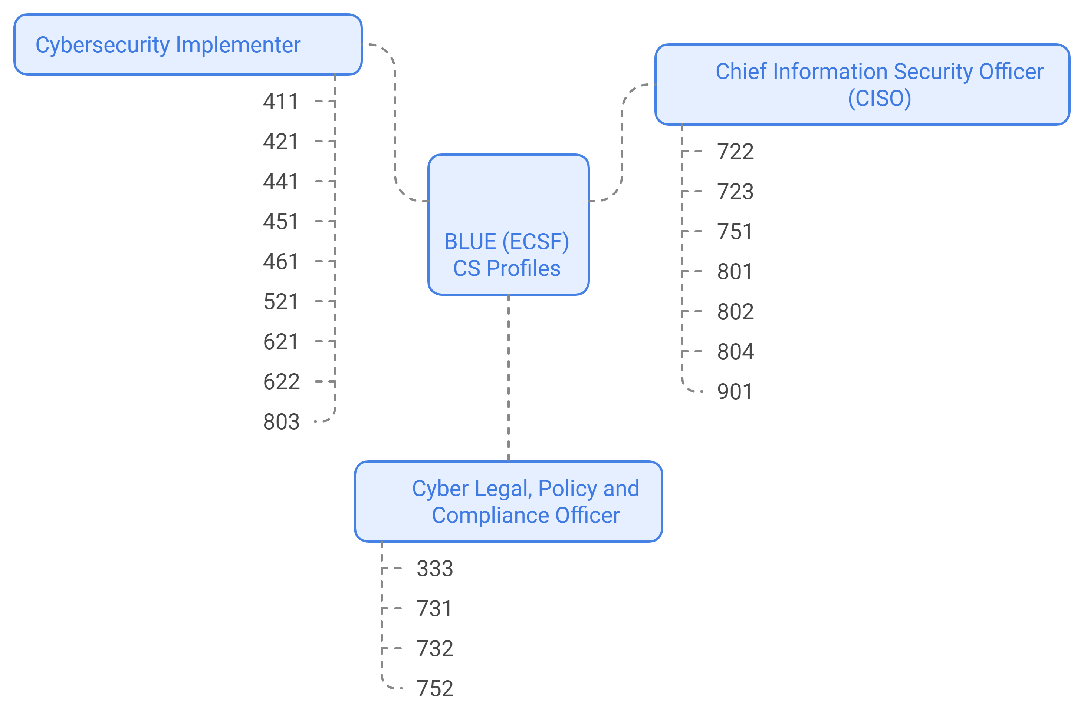
Chief Information Security Officer (CISO)
Cyber Incident Responder
Cyber Legal, Policy and Compliance Officer
Cyber Threat Intelligence Specialist
Cybersecurity Architect
Cybersecurity Auditor
Technical Support
Database Administration
Systems Security Management
Network Operations
Communications Security Management
Systems Administration
CyberSecurity Workforce Management
Systems Security Analysis
Program Management
Infrastructure Support
Secure Project Management
Secure Software Development
Technology Portfolio Management
Software Security Assessment
Executive Cybersecurity Management
Product Support Management
Partner Integration Planning
Cybersecurity Legal Advice
Privacy Compliance
Cybersecurity Poilicy & Planning
Cybersecurity Educator
Cybersecurity Implementer
Cybersecurity Researcher
Cybersecurity Risk Manager
Digital Forensics Investigator
Penetration Tester

Slide 22
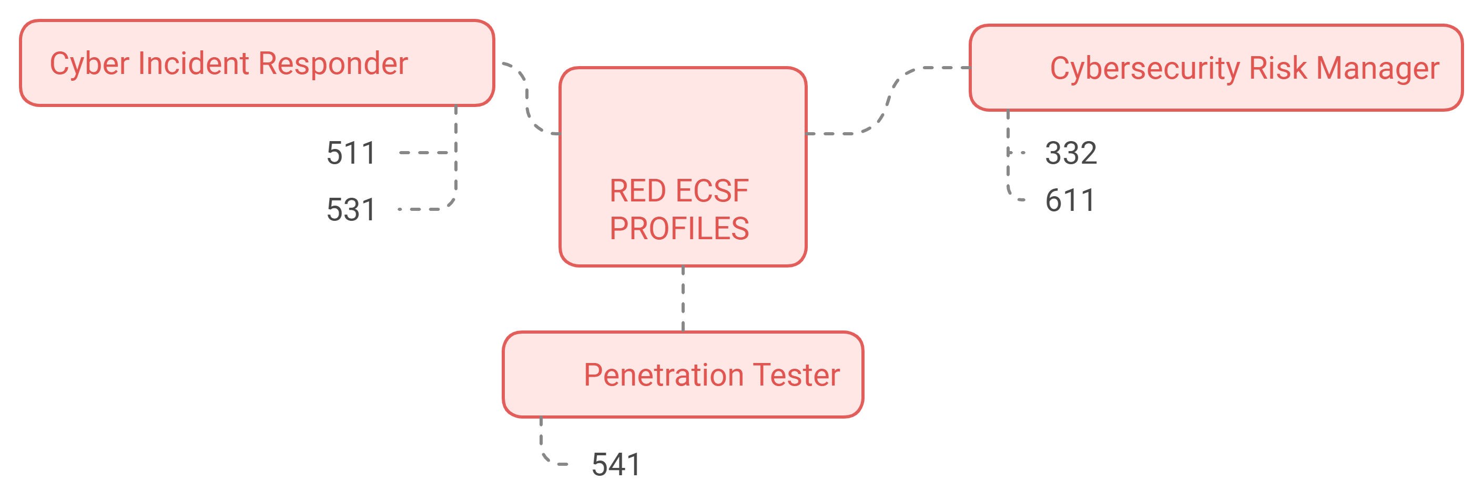
Chief Information Security Officer (CISO)
Cyber Incident Responder
Cyber Legal, Policy and Compliance Officer
Cyber Threat Intelligence Specialist
Cybersecurity Architect
Cybersecurity Auditor
Defensive Cybersecurity
Cyber Operations Planning
Incident Responder
Systems Authorization
NEW
Insider Threat Analysis
Vulnerability Analysis
Cybersecurity Educator
Cybersecurity Implementer
Cybersecurity Researcher
Cybersecurity Risk Manager
Digital Forensics Investigator
Penetration Tester

Slide 23
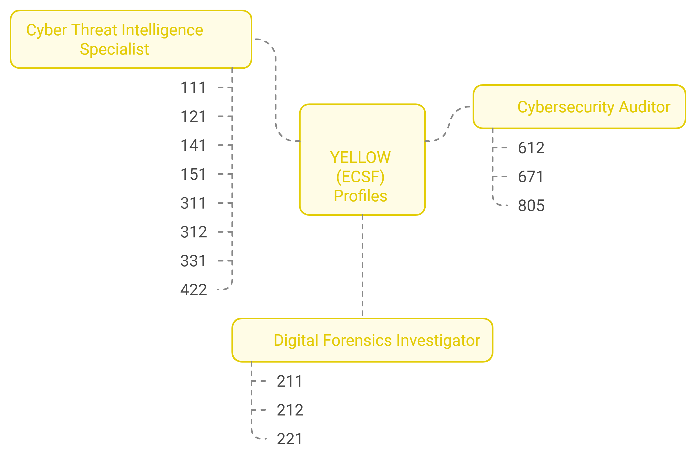
Chief Information Security Officer (CISO)
Cyber Incident Responder
Cyber Legal, Policy and Compliance Officer
Cyber Threat Intelligence Specialist
Cybersecurity Architect
Cybersecurity Auditor
All-Source Analysis
Exploitation Analysis
Threat Analysis
Security Control Assessment
Multi-Disciplined Language Analysis
Systems Testing & Evaluation
All-Source Collection Management
Technology Program Auditing
All-Source Collection RequirementsManagement
Cyber Intelligence Planning
Data Analysis
Digital Evidence Analysis
Digital Forensics
Cybercrime Investigation
Cybersecurity Educator
Cybersecurity Implementer
Cybersecurity Researcher
Cybersecurity Risk Manager
Digital Forensics Investigator
Penetration Tester

Slide 24
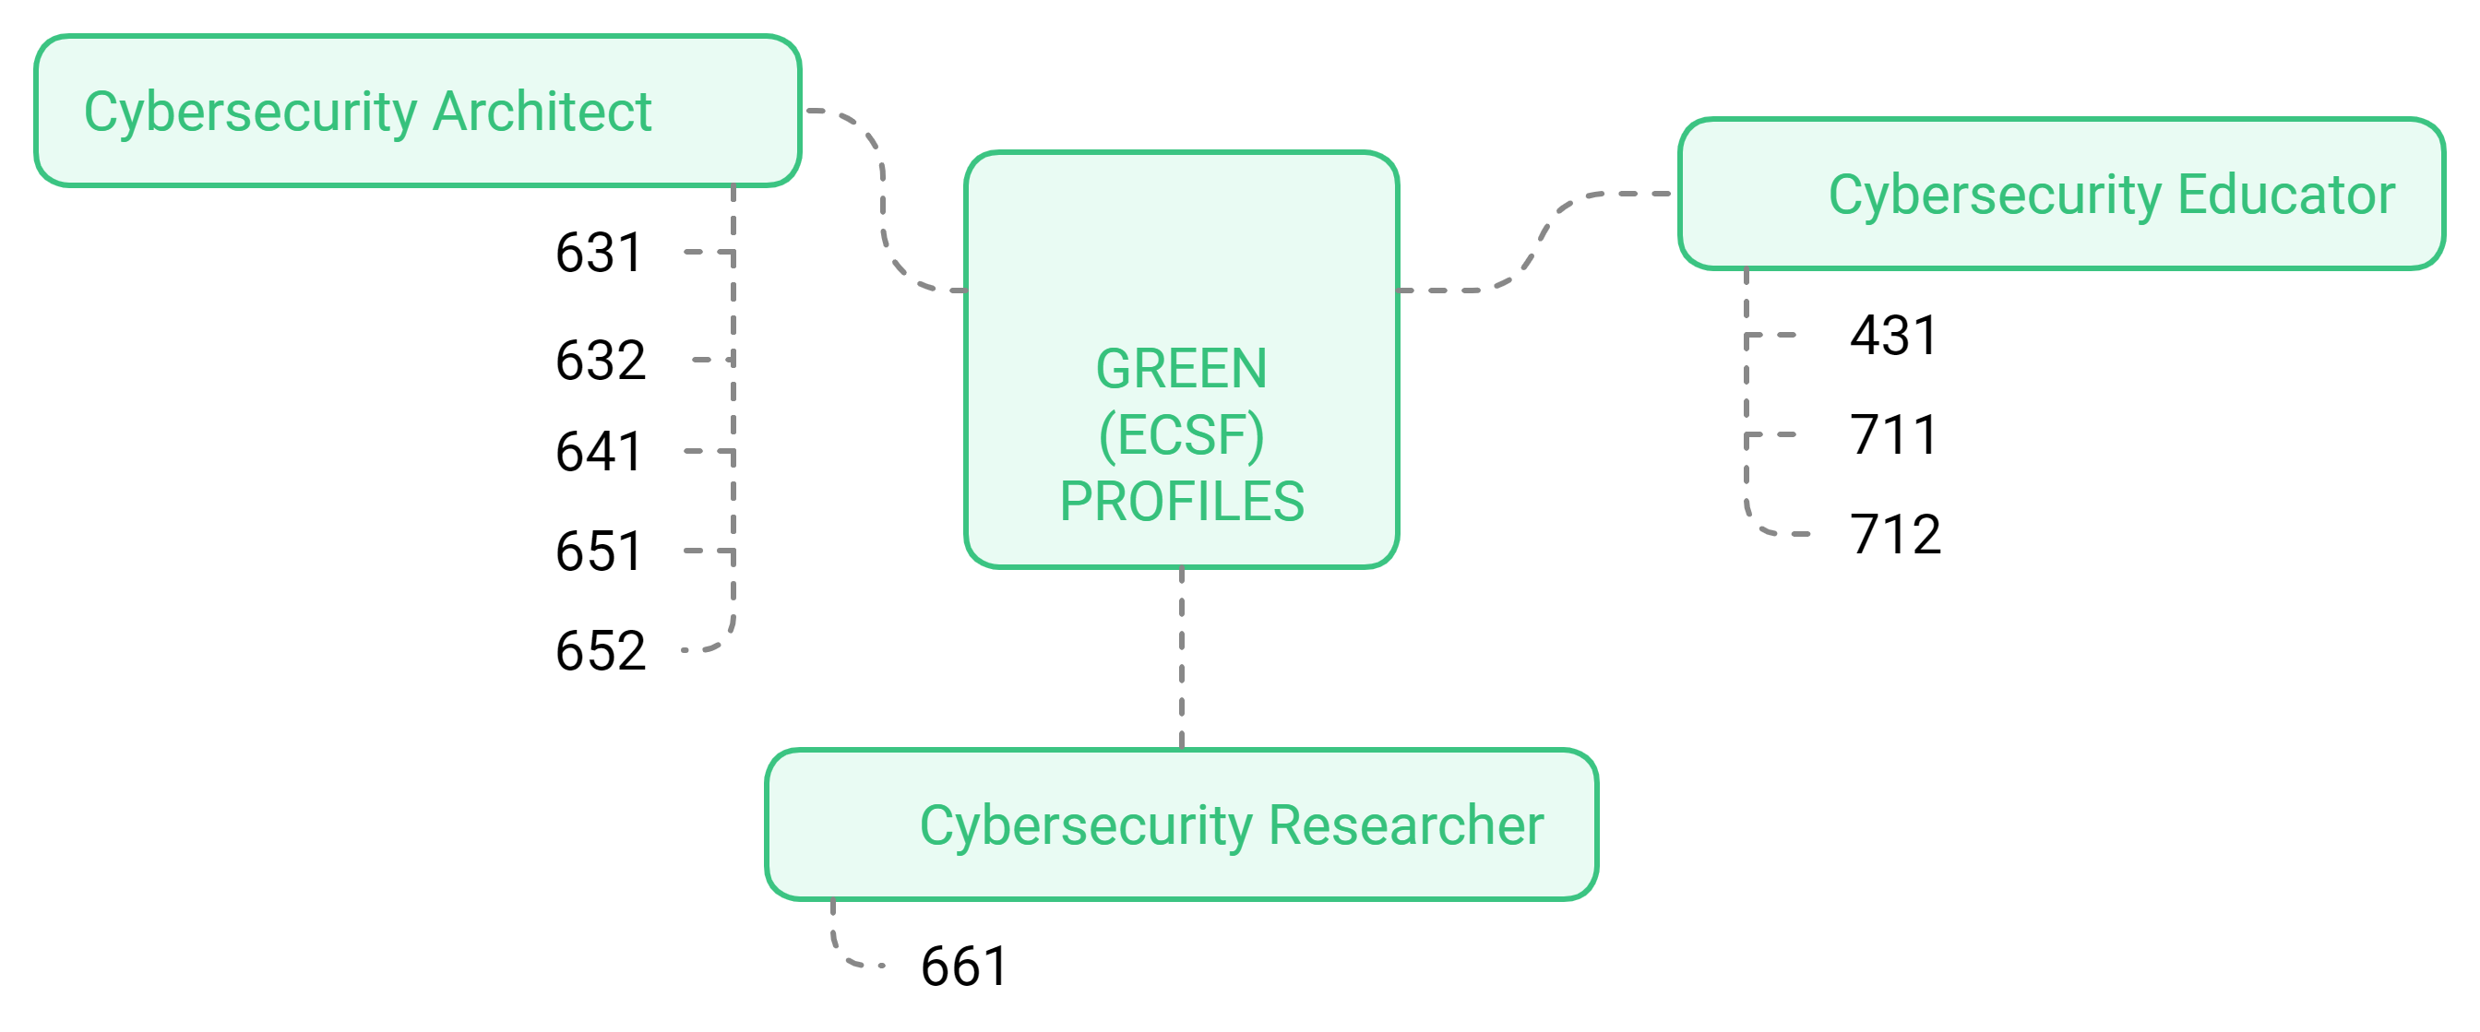
Chief Information Security Officer (CISO)
Cyber Incident Responder
Cyber Legal, Policy and Compliance Officer
Cyber Threat Intelligence Specialist
Cybersecurity Architect
Cybersecurity Auditor
Secure Systems Development
Secure Systems Development
Knowledge Management
Systems Requirements Planning
Cybersecurity Curriculum Development
Enterprise Architecture
Cybersecurity Instruction
Cybersecurity Architecture
Technology Research & Development
Cybersecurity Educator
Cybersecurity Implementer
Cybersecurity Researcher
Cybersecurity Risk Manager
Digital Forensics Investigator
Penetration Tester

Slide 25
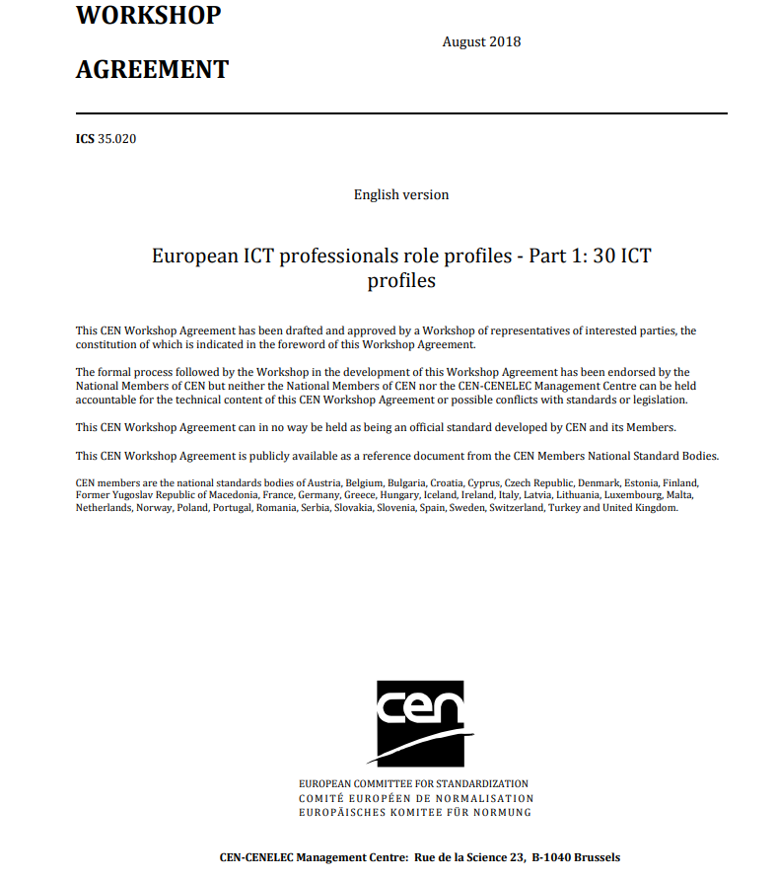

https://itprofessionalism.org/wp-content/uploads/2025/03/ICT-professionals-role-profiles-Pt-1-CWA-16458-1.pdf
https://itprofessionalism.org/professionalism/e-competence-framework/
https://itprofessionalism.org/about/

Slide 26
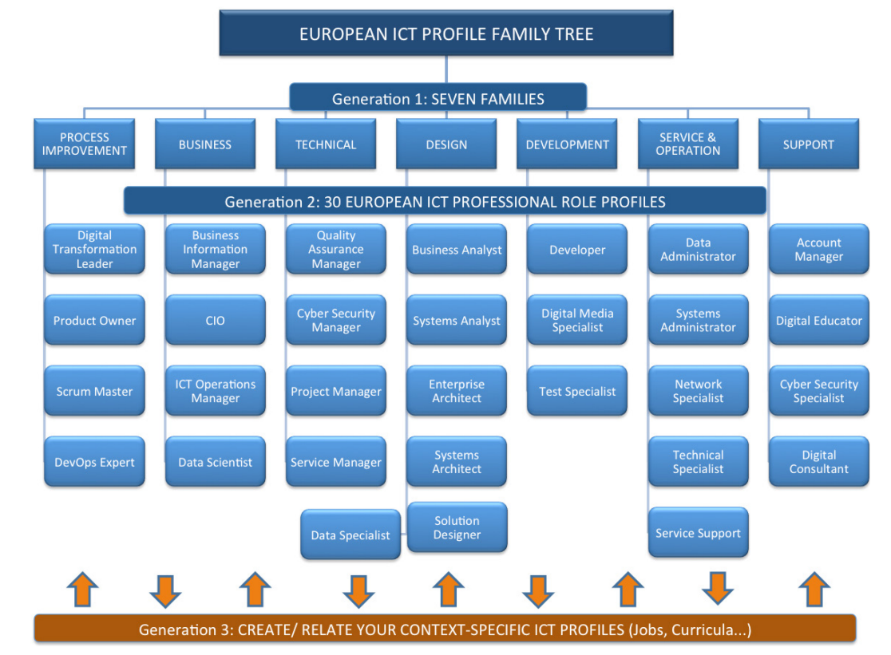
Figure 1: European ICT Professional Role Profiles version 2: 30 profiles (generation 2) in seven families (generation 1) at the top of the European ICT Profile Family Tree

Slide 27
